Slide 1
Incidents and postmortems.
SRE Team

Slide 2
SRE Orderbook - Incident Report: Latency Error on (insert date)
Summary: On (insert date), our system experienced a significant increase in latency, resulting in slower response times for our customers. This incident lasted for approximately (insert hours), from (time) to (time) GMT. The issue was identified and resolved by our SRE team.
9:30 AM GMT: Our team identified that one of the servers in our backend infrastructure was experiencing high CPU utilization, leading to slower response times.
10:00 AM GMT: We attempted to scale up the capacity of the affected server and optimize our database queries to alleviate the high CPU usage. However, these measures were not sufficient in resolving the issue.
11:00 AM GMT: Our team discovered that the high CPU usage was caused by a long-running process that was not optimized for performance. We stopped the process and restarted the server, which immediately resolved the latency issues.
12:00 PM GMT: Our system returned to normal operating conditions, and all customers regained full functionality.

Slide 3
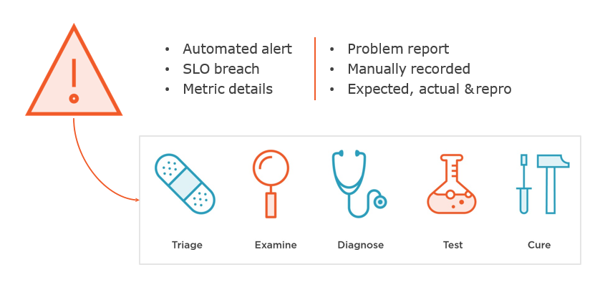
Incident model

Slide 4
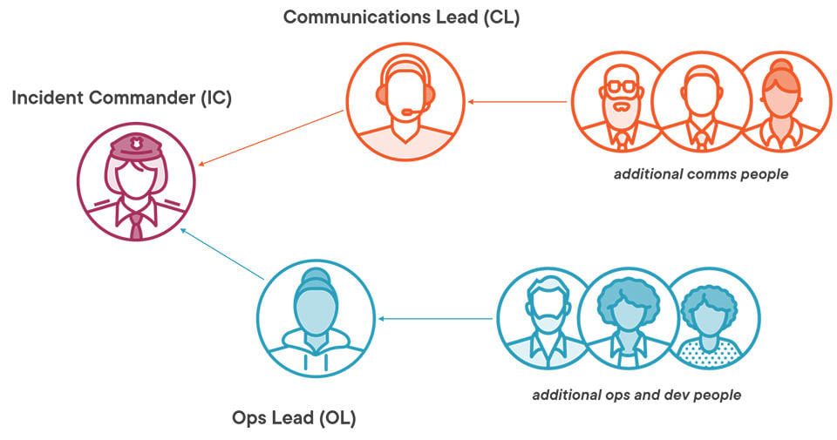
Control, Co-ordinate & Communicate.

Slide 5
Post-mortem
Root Cause: The root cause of the latency error was caused by a long-running process that was not optimised for performance. This process was causing high CPU utilisation on one of our backend servers, resulting in slower response times.
Mitigation and Resolution: To mitigate the issue, our team scaled up the capacity of the affected server and optimised our database queries. However, these measures were not enough to resolve the problem. The issue was eventually resolved by stopping the long-running process and restarting the server.
Preventative Measures: To prevent similar issues from occurring in the future, we will implement the following preventative measures:
Regular code reviews: We will implement regular code reviews to ensure that all processes are optimised for performance.
Improved monitoring: We will enhance our system monitoring tools to better detect issues with high CPU utilisation and respond to them more quickly.
Disaster recovery testing: We will regularly test our disaster recovery procedures to ensure that we can quickly and effectively respond to any incidents that may arise.
Conclusion: We apologise for the inconvenience.
We take the reliability and performance of our services seriously and will continue to take measures to ensure that incidents like this do not occur in the future.

Slide 6
Reduction of Toil
To reduce toil in the future, the SRE team will automate the process of detecting and resolving high CPU utilisation issues. For example, we would implement an automated system that detects when CPU utilisation is above a certain threshold using Grafana and automatically scale up the capacity of affected servers or reallocate workloads to other servers to reduce CPU usage.
Additionally, we could look into optimising our code and processes to prevent high CPU utilisation in the first place, reducing the need for manual interventions. Regular code reviews and performance testing could help identify and address performance issues before they cause problems issues.

